Slide 2

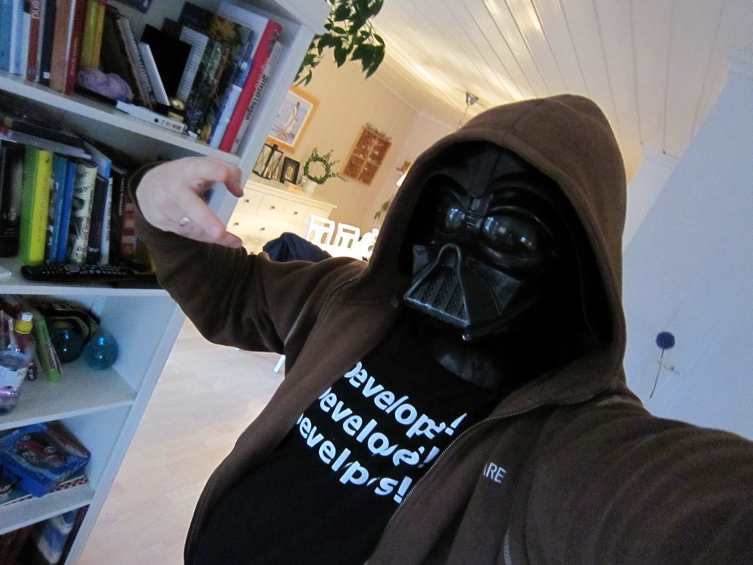




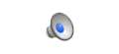
Azure
Going mobile
einar@dolittle.com
twitter.com/einari
http://www.ingebrigtsen.info

Slide 3



What is the cloud?
… apparently, the Cloud is somewhere in Virginia…
Notes:
Slide Objectives:
Explain how Microsoft thinks of the cloud
Speaking Points:
There are numerous terms and definitions floating around in the industry for “the cloud”, “cloud computing”, “cloud services”, etc.
Microsoft thinks of the cloud as simply an approach to computing that enables applications to be delivered at scale for a variety of workloads and client devices.
The cloud can help deliver IT as a standardized service…freeing you up to focus on your business

Slide 4

Cloud Workflow Patterns
“On and Off “
“Growing Fast“
Inactivity
Period
Compute
Compute
Average
Usage
Average Usage
Time
Time
On & off workloads (e.g. batch job)
Over provisioned capacity is wasted
Time to market can be cumbersome
Successful services needs to grow/scale
Keeping up w/ growth is big IT challenge
Cannot provision hardware fast enough
“Unpredictable Bursting“
“Predictable Bursting“
Compute
Compute
Average Usage
Average Usage
Time
Time
Unexpected/unplanned peak in demand
Sudden spike impacts performance
Can’t over provision for extreme cases
Services with micro seasonality trends
Peaks due to periodic increased demand
IT complexity and wasted capacity
Notes:
Slide Objective
Understand common cloud utilization patterns
Speaking Points:
On/Off
Application only runs at certain times
E.g. batch processing, running simulation jobs etc…
Growing fast
Business growing too fast to be able to use regular hosting approach- cannot procure and provision hardware fast enough
E.g. Startup that goes Viral
Unpredictable Bursting
Sudden news event massively increases demand on application
Ability to scale may be difference between staying up (and making lots of money) and failing due to too much demand
E.g. Pop Start fan site when the pop star dies
Predictable Bursting
Well know periods of peak demands
e.g. Tickets going on sale for a big rock concert

Slide 5
Cloud Services
Packaged Software
Infrastructure
(as a Service)
Platform
(as a Service)
Software
(as a Service)
Applications
Applications
You manage
Applications
Applications
Data
You manage
Data
Data
Data
Runtime
Runtime
Runtime
Runtime
Managed by vendor
You manage
Middleware
Middleware
Middleware
Middleware
Managed by vendor
O/S
O/S
O/S
O/S
Virtualization
Virtualization
Managed by vendor
Virtualization
Virtualization
Servers
Servers
Servers
Servers
Storage
Storage
Storage
Storage
Networking
Networking
Networking
Networking
Notes:
Slide Objectives:
Explain the differences and relationship between IaaS, PaaS, and SaaS in more detail.
Speaking Points:
Here’s another way to look at the cloud services taxonomy and how this taxonomy maps to the components in an IT infrastructure.
Packaged Software
With packaged software a customer would be responsible for managing the entire stack – ranging from the network connectivity to the applications.
IaaS
With Infrastructure as a Service, the lower levels of the stack are managed by a vendor. Some of these components can be provided by traditional hosters – in fact most of them have moved to having a virtualized offering.
Very few actually provide an OS
The customer is still responsible for managing the OS through the Applications.
For the developer, an obvious benefit with IaaS is that it frees the developer from many concerns when provisioning physical or virtual machines.
This was one of the earliest and primary use cases for Amazon Web Services Elastic Cloud Compute (EC2).
Developers were able to readily provision virtual machines (AMIs) on EC2, develop and test solutions and, often, run the results ‘in production’.
The only requirement was a credit card to pay for the services.
PaaS
With Platform as a Service, everything from the network connectivity through the runtime is provided and managed by the platform vendor.
The Windows Azure Platform best fits in this category today.
In fact because we don’t provide access to the underlying virtualization or operating system today, we’re often referred to as not providing IaaS.
PaaS offerings further reduce the developer burden by additionally supporting the platform runtime and related application services.
With PaaS, the developer can, almost immediately, begin creating the business logic for an application.
Potentially, the increases in productivity are considerable and, because the hardware and operational aspects of the cloud platform are also managed by the cloud platform provider, applications can quickly be taken from an idea to reality very quickly.
SaaS
Finally, with SaaS, a vendor provides the application and abstracts you from all of the underlying components.

Slide 6








Cloud Offerings
Full Platform Stack
Limited Stack

Slide 7
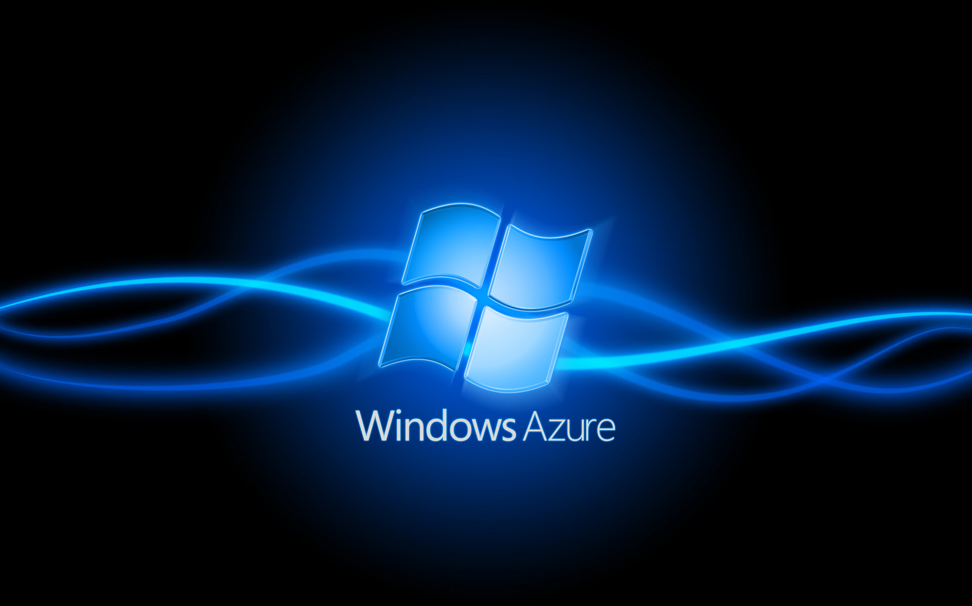

Slide 8



What is Windows Azure
Designed for scalability and availability

Slide 9
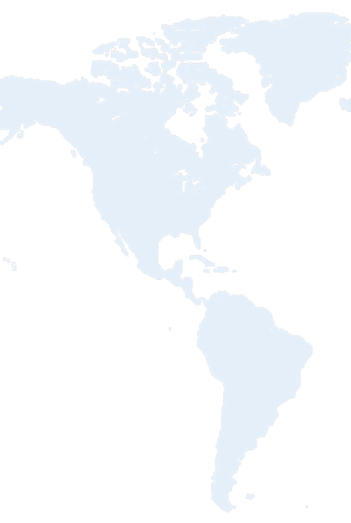
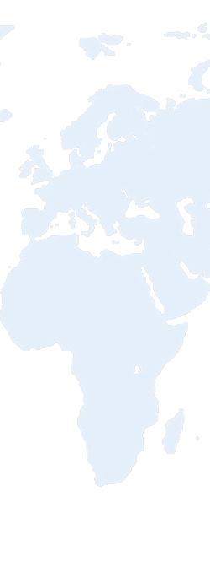
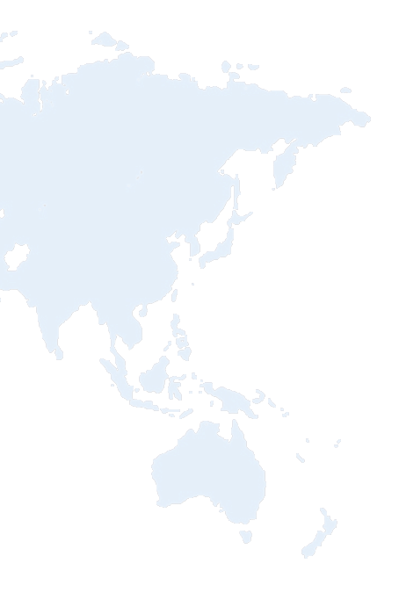


What is Windows Azure
Hosted by Microsoft
North America Region
Europe Region
Asia Pacific Region
N. Europe
W. Europe
N. Central – U.S.
S. Central – U.S.
E. Asia
S.E. Asia
6 datacenters across 3 continents
Notes:
Slide Objective
Understand that Microsoft has a long history in running data centres and online applications. Bing, Live, Hotmail etc….
Understand the huge amount of innovation going on at the data center level
Speaking Points:
Microsoft is one of the largest operators of datacenters in the world
Years of Experience
Large scale trustworthy environments
Driving for cost and environmental efficiently
Windows Azure runs in 3 regions and 6 datacenters today
Data center innovation is driving improved reliability and efficiency
PUE = Power Usage Effectiveness = Total Facility power/IT Systems Power = Indication of efficiency of DC
Under 1.8 is very good, modern cloud DCs approaching 1.2
Multi-billion dollar datacenter investment
700,000+ square foot Chicago and the 300,000+ square foot Dublin, Ireland data centers
Microsoft cloud services provide the reliability and security you expect for your business: 99.9% uptime SLA, 24/7 support.
Microsoft understands the needs of businesses with respect to security, data privacy, compliance and risk management, and identity and access control. Microsoft datacenters are ISO 27001:2005 accredited, with SAS 70 Type I and Type II attestations.
Notes:
http://www.globalfoundationservices.com/
http://blogs.msdn.com/the_power_of_software/archive/2008/06/20/microsoft-s-pue-experience-years-of-experience-reams-of-data.aspx
http://blogs.msdn.com/the_power_of_software/archive/2008/06/27/part-2-why-is-energy-efficiency-important.aspx

Slide 10
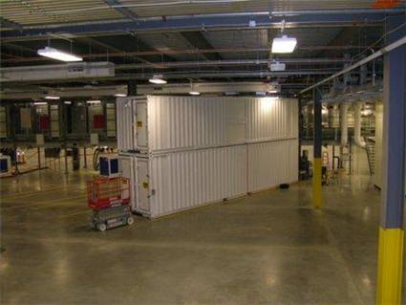
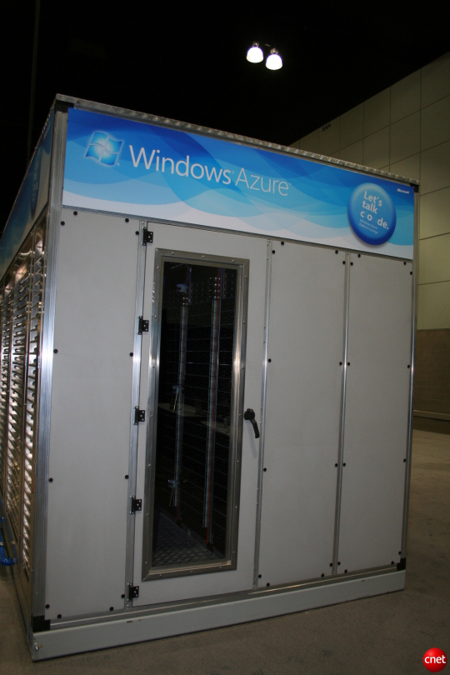
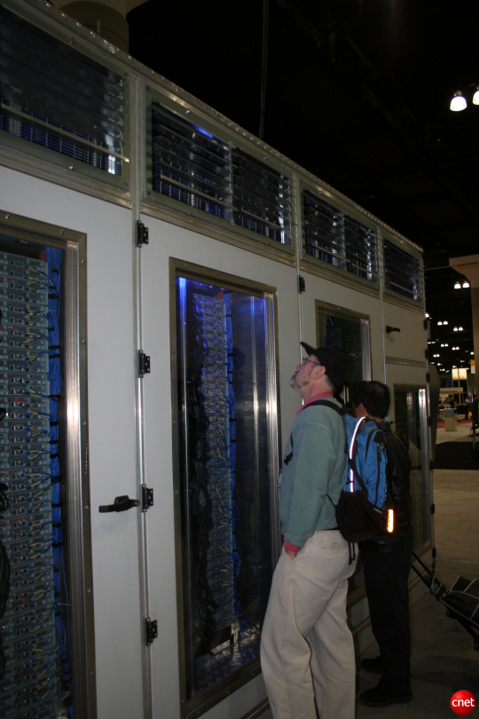
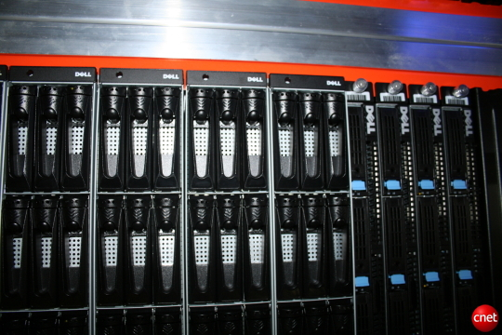
http://www.youtube.com/watch?v=8E8Wy3An3jA

Slide 11
What is Windows Azure
Features
Automated Service Management
Compute
Storage
Developer Experience
Notes:
Here are some of the features we’ll walk through in the next few minutes.

Slide 12

What is Windows Azure
Compute
Storage
AppFabric
Developer
SDK
Notes:
For you as a developer, there are 3 concepts you can be working with.
Compute – this is were you have your applications.
Storage – this is were you store your data
AppFabric – this is were you plugin existing infrastructure – Active Directory, ESB, etc...

Slide 13

The tools
Visual Studio 2008
Visual Studio 2010
Azure SDK

Slide 14
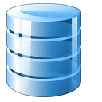
SQL Azure
Database Replicas

Slide 15

Storage
100 TB per account
Blobs, Drives, Tables, Queues
Designed for the cloud
3 replicas
Guaranteed consistency
Accessible directly from the internet via REST API
.NET Client library supported
Does not require compute
Storage account drives unique URL, e.g.:
https://<youraccount>.blob.core.windows.net
Notes:
In this next section, we’ll dig a little deeper on storage.
Recall there are 3 types of storage.
Recall the design point is for the cloud, there are 3 replicas of data, and we implement guaranteed consistency. In the future there will be some transaction support and this is why we use guaranteed consistency.
Access is via a storage account – you can have multiple storage accounts per project.
Although the API is REST, there is a supported .net storage client in the SDK that you can use within your project. This makes working with storage much easier.

Slide 16


Slide 17
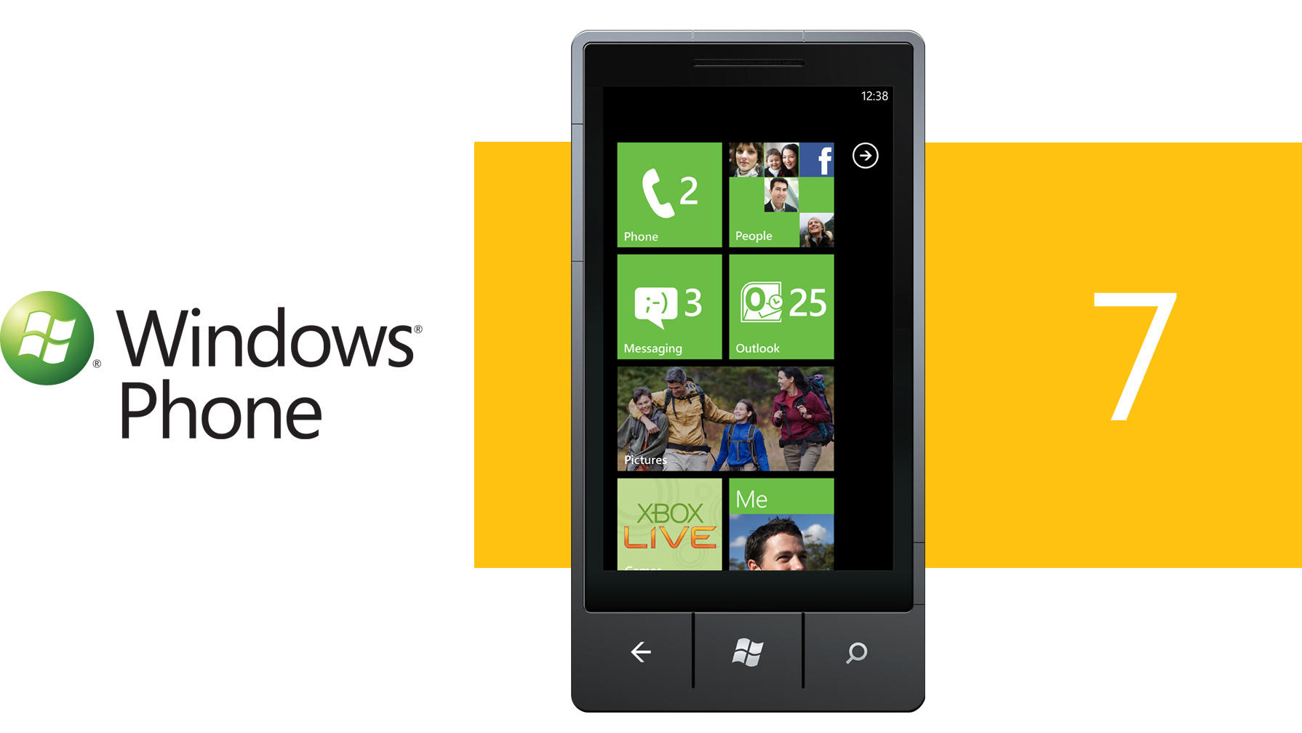

Slide 18

http://watoolkitwp7.codeplex.com/

Slide 19

iOS
https://github.com/microsoft-dpe/wa-toolkit-ios

Slide 20

Android
https://github.com/microsoft-dpe/wa-toolkit-android

Slide 22

Resources
Project and Presentation http://github.com/einari/gadgetshop
Windows Azure Platform http://www.azure.com/
Windows Azure Platform Training Kit http://www.microsoft.com/downloads/details.aspx?FamilyID=413E88F8-5966-4A83-B309-53B7B77EDF78&displaylang=en

Slide 23


Slide 24


Slide 25


